Slide 1
Image Processing
Lecture 7
Introducing Image Processing

Slide 2
Image Enhancement
in the frequency Domain

Slide 3
Introduction
So far we processed the image directly.
This means that the transformation was a function of the image itself depending on (coordinates and gray levels ).
We called this the SPATIAL domain.
So what’s the FREQUENCY domain ?

Slide 4
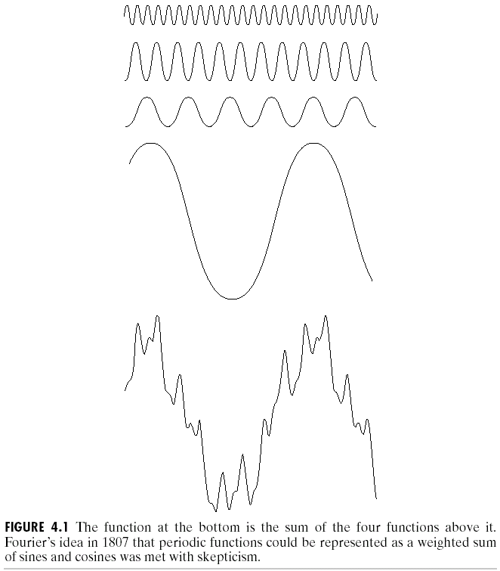
Fourier Transform
Any function that periodically repeats itself can be expressed as the sum of sines/cosines of different frequencies, each multiplied by a different coefficient.

Slide 5
Fourier Transform

Slide 6
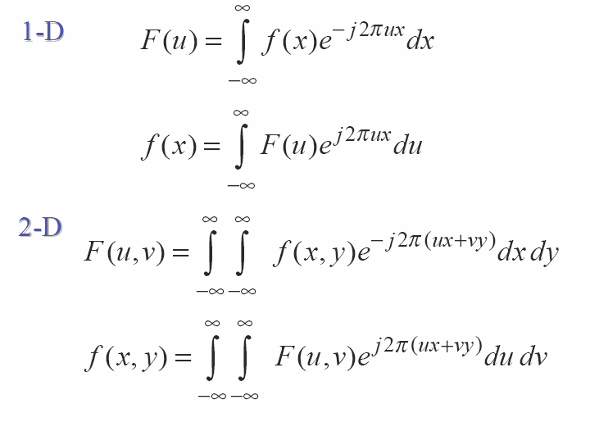
Fourier Transform
With : e^{ix}=cos(x)+ i sin(x)

Slide 7
Inverse Fourier Transform
Inverse 1D :
Inverse 2D :

Slide 8
Fourier Transform

Slide 9
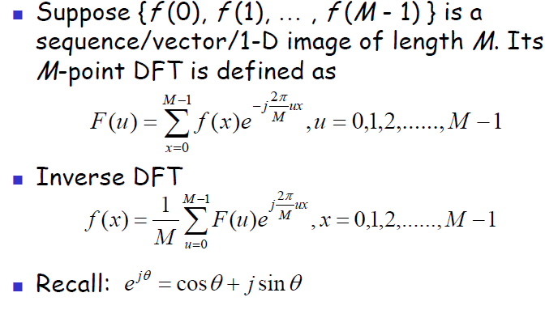
1D
Discrete Fourier Transform (DFT)

Slide 10
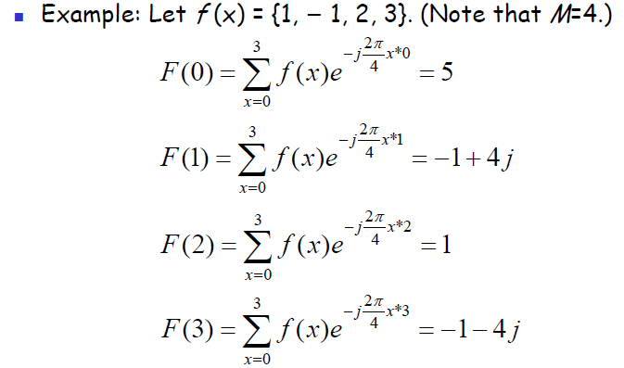
Example

Slide 11
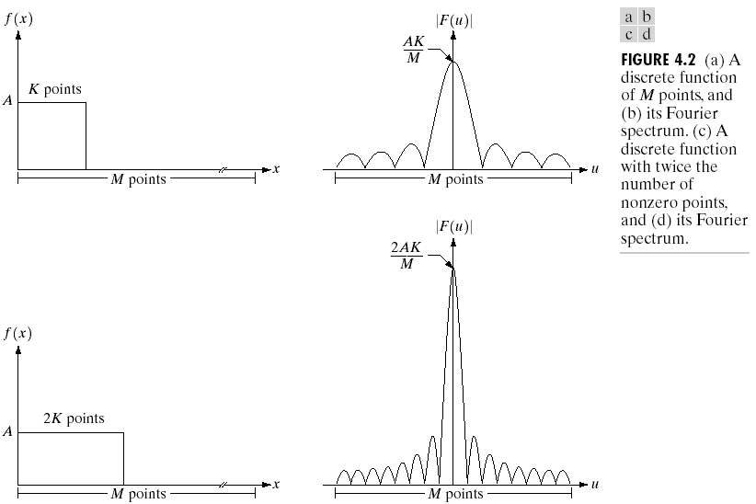
Fourier Spectrum

Slide 12
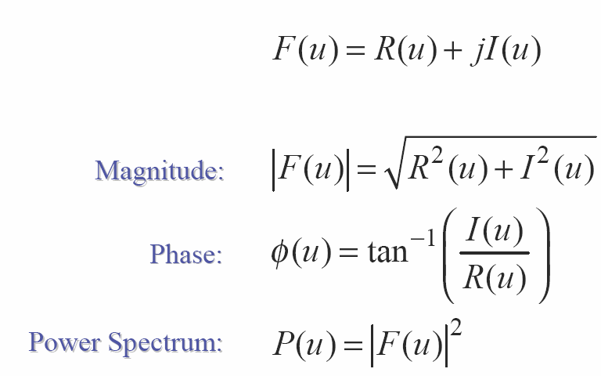
Magnitude, Phase and Power
Spectrum

Slide 13
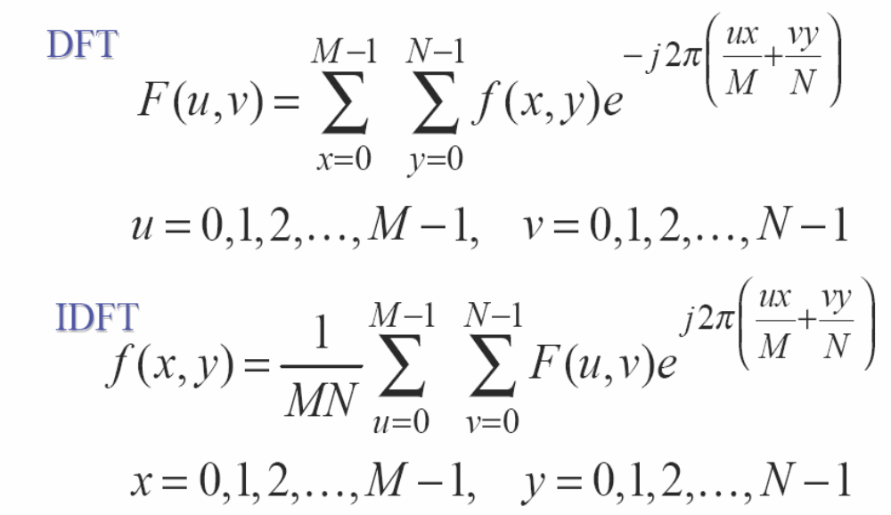
2D DFT

Slide 14
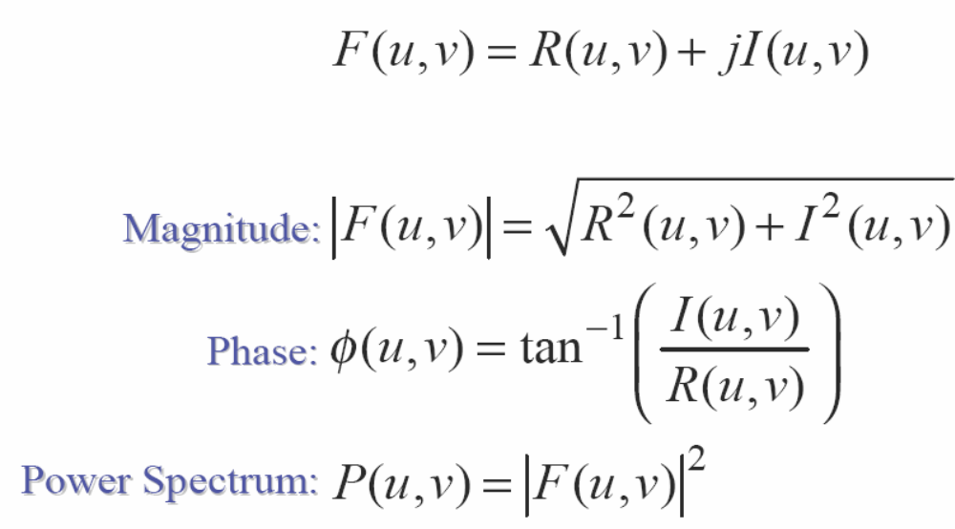
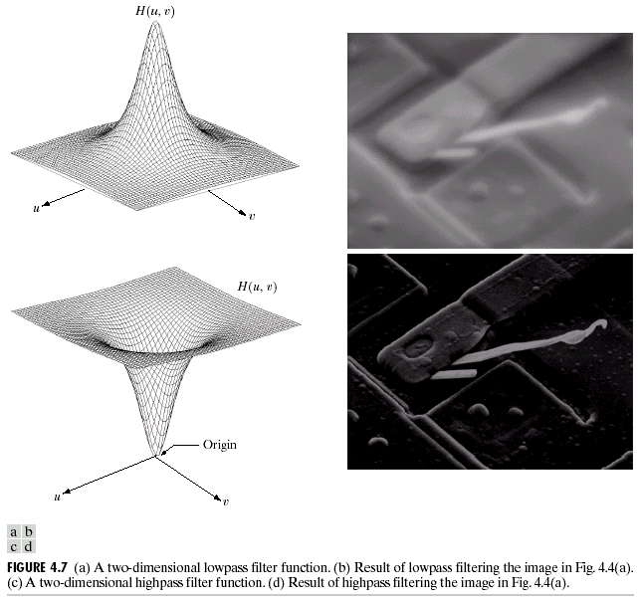
Magnitude, Phase and Power
Spectrum

Slide 15
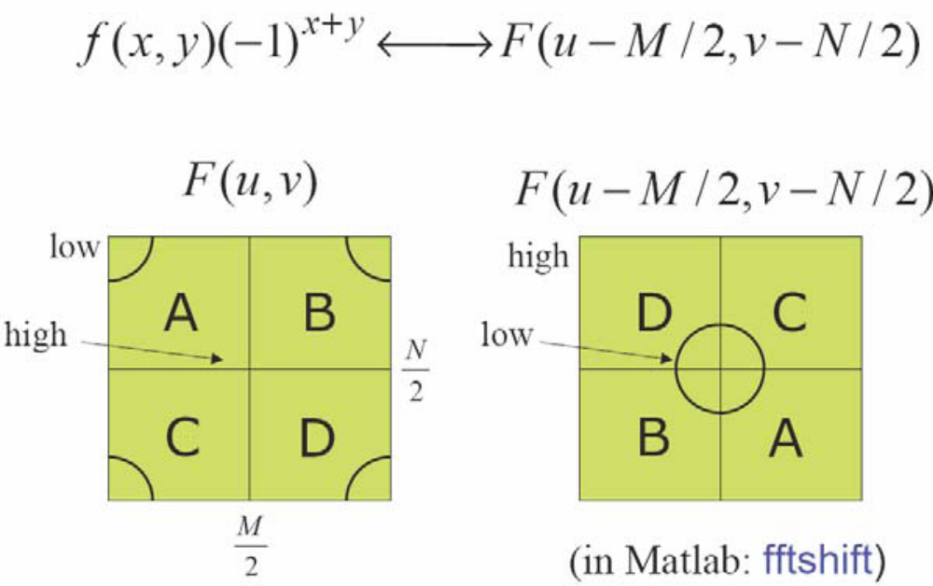
Displaying the 2-D DFT

Slide 16
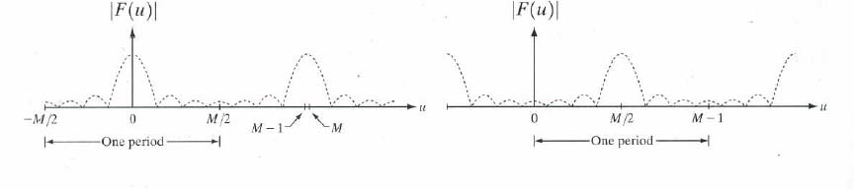
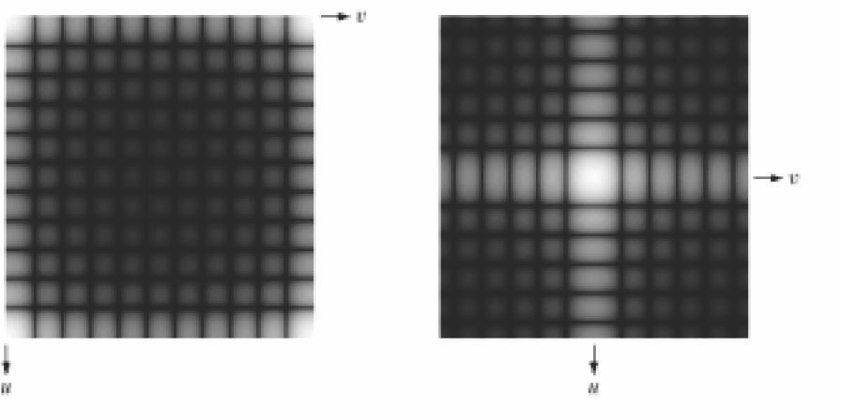
Displaying the 2-D DFT

Slide 17
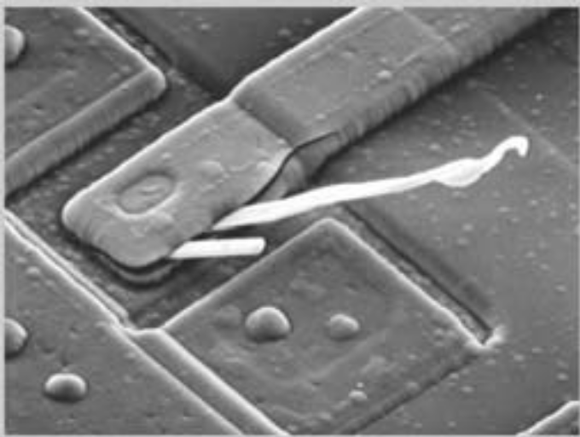

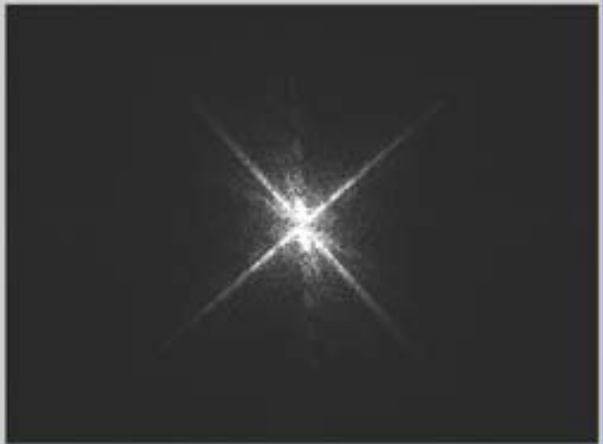
2D DFT : Example

Slide 18
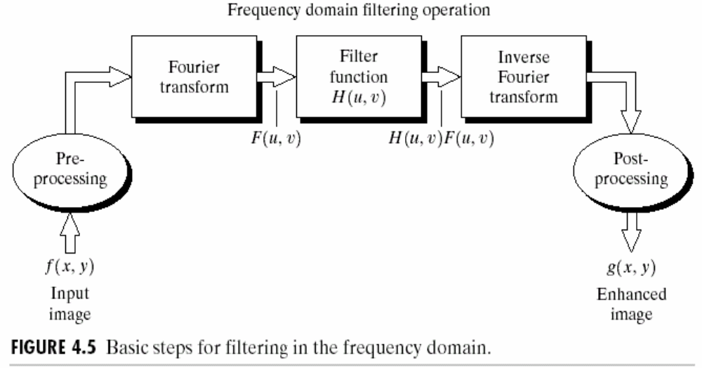
Basic steps for filtering in the frequency domain
G(u,v) = H(u,v)F(u,v)

Slide 19
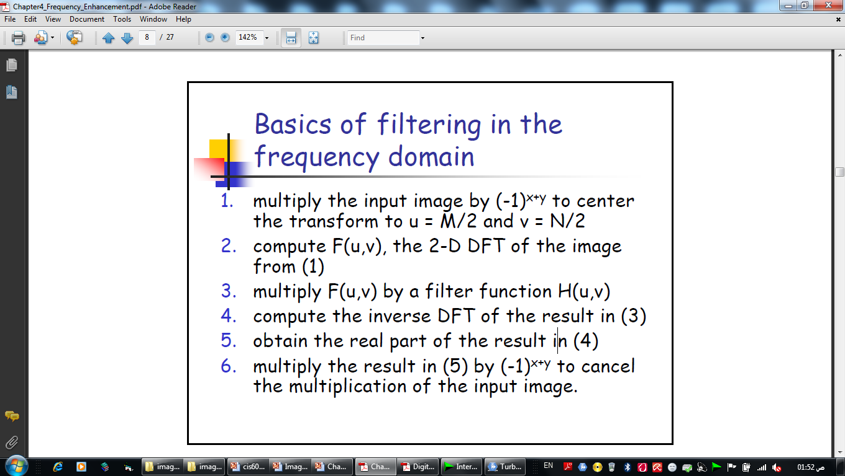
Basic steps for filtering in the frequency domain

Slide 20
Lowpass Filter (LPF)
Edges and sharp transitions in gray values in an image contribute significantly to high-frequency content of its Fourier transform.
Regions of relatively uniform gray values in an image contribute to low-frequency content of its Fourier transform.
Hence, an image can be smoothed in the Frequency domain by attenuating the high-frequency content of its Fourier transform. This would be a lowpass filter!

Slide 21
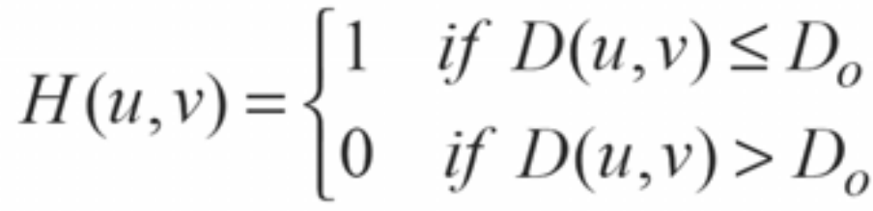

Ideal lowpass filter
G(u,v) = H(u,v) F(u,v)
Where D(u,v) is the distance from point (u,v) to the origin of the frequency rectangle

Slide 22
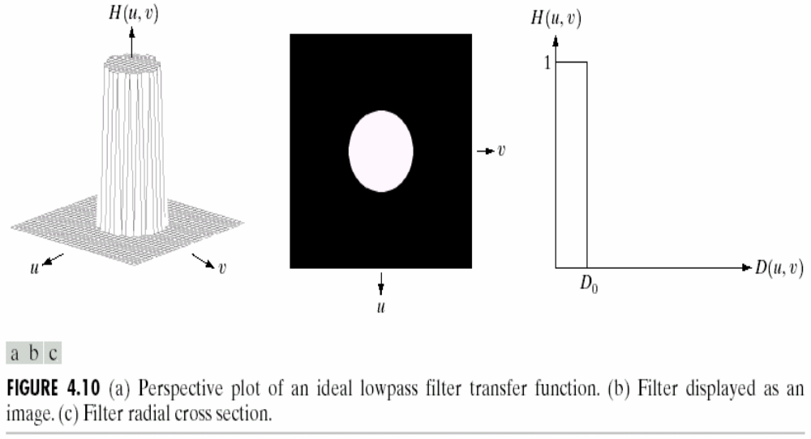
Ideal lowpass filter

Slide 23
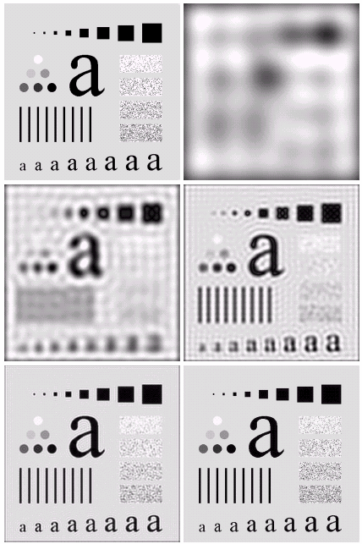
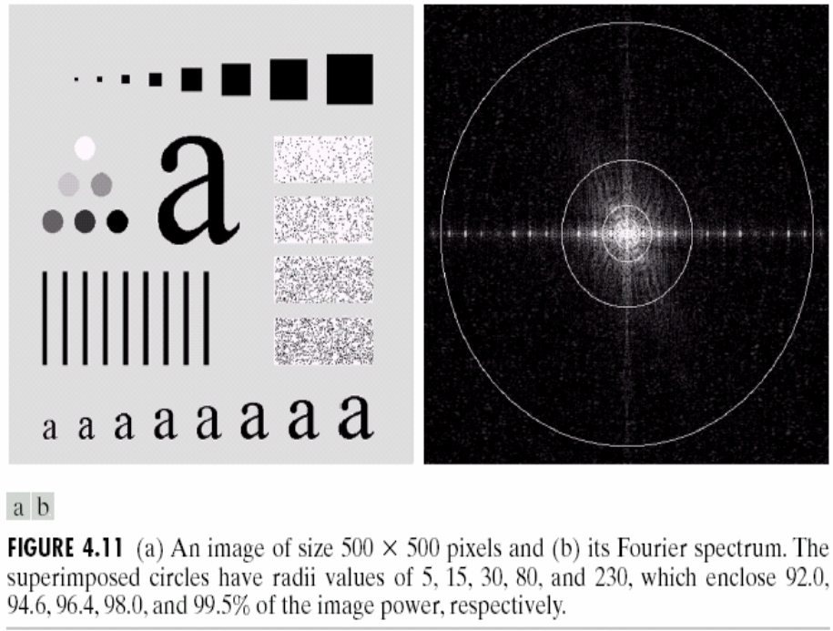
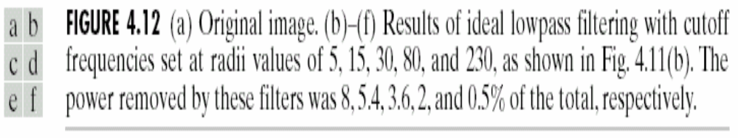
Ideal lowpass filter

Slide 24
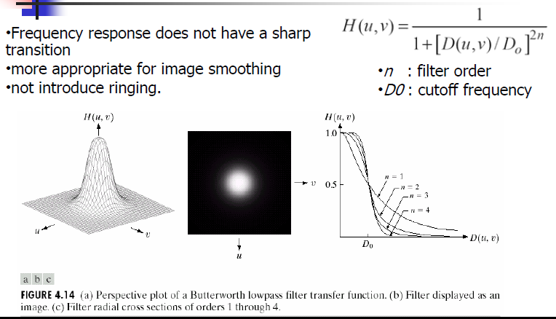
Other LowPass Filter
Butterworth Lowpass Filter )BLPF)

Slide 25
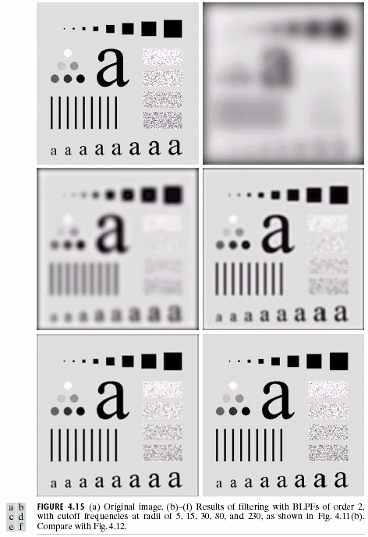
Butterworth Lowpass Filter )BLPF)

Slide 26
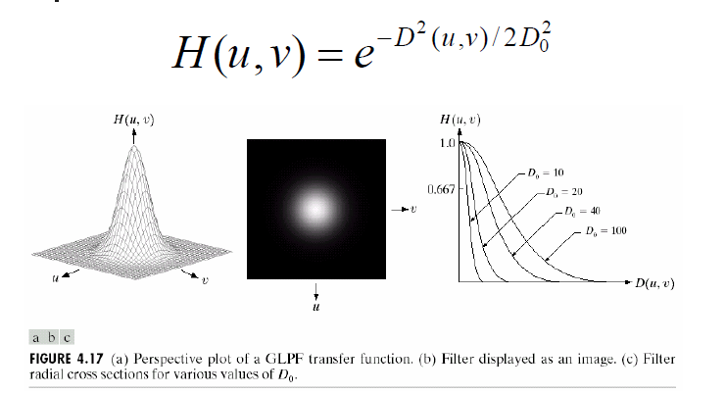
Gaussian Lowpass Filter: GLPF

Slide 27
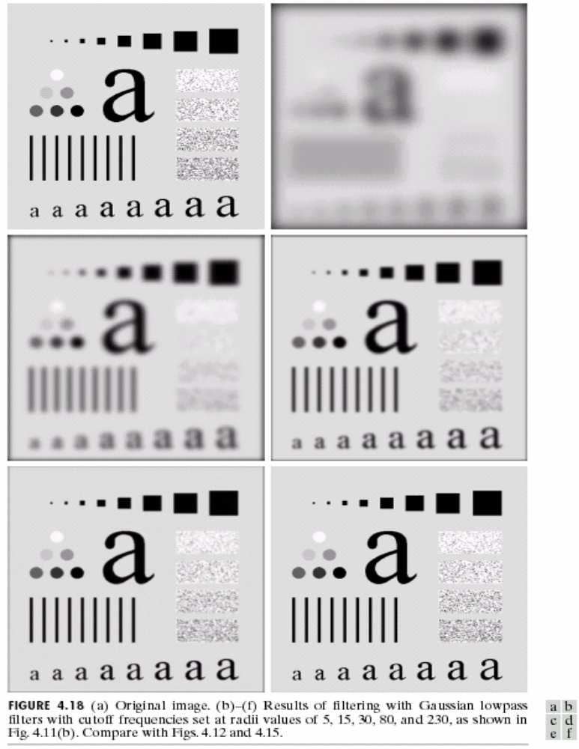

Slide 28
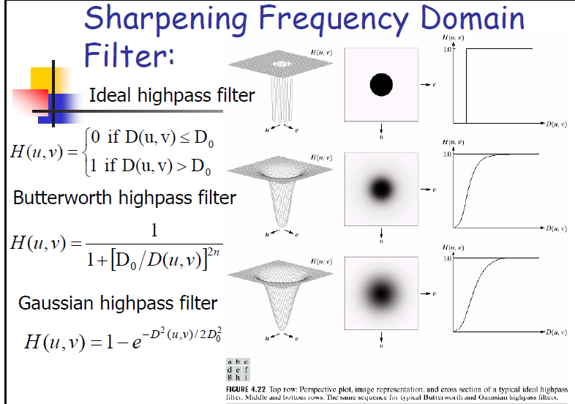
HighPass Filter

Slide 29
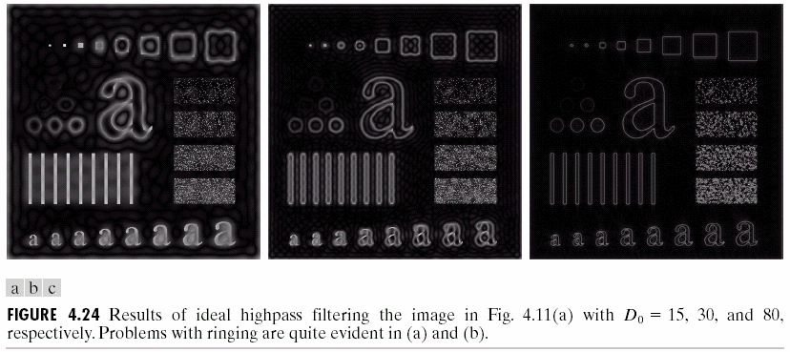
Example : IHPF

Slide 30
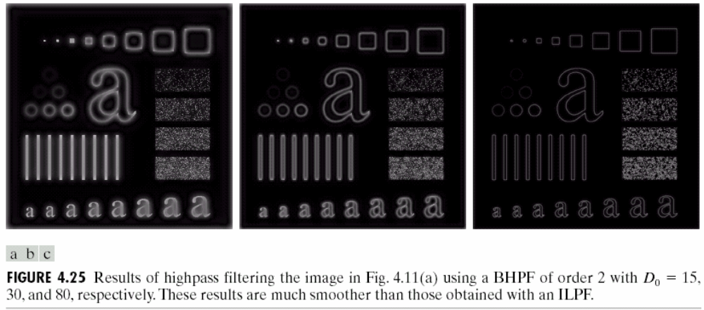
Example : BHPF

Slide 31
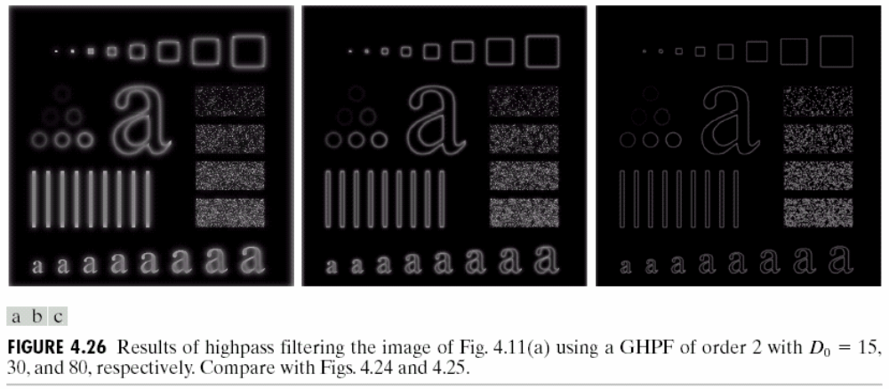
Example : GHPF

